Slide 1
Ch 4: Program Comprehension
Part 3
Program Analysis
Program Slicing

Slide 2
Outline
Introduction
Static Slicing
Refactoring
2

Slide 3
Introduction
The size and complexity of a software today gets harder to understand, maintain and test
You might have had questions like:
If I change this statement, what pieces of the program are going to be affected?
Where are the values that flow into this statement coming from?
How can I limit the functionality to only what I need?

Slide 4
Introduction
Goals:-
Debug your thousands lines of code easily by reducing the complexity of the program.
Write a robust program before testing your code.
Save your regression testing time by limiting the tests to only those that exercise the changed code.

Slide 5
Introduction
How ?
-“Break larger code into smaller pieces”
During program design, some known decomposition techniques are
-Information hiding and data abstraction
Unlike most other methods, slicing is applied to programs after they are written, and is therefore useful in maintenance rather than design

Slide 6
What is program slicing?
Program slice is a decomposition technique that extracts statements relevant to a particular computation from a program
Program slices was first introduced by Mark Weiser (1980) are known as executable backward static slices
Program slicing describes a mechanism which allows the automatic generation of a slice

Slide 7
What is program slicing?
Slicing criterion <s , v>
- Where s specifies a location (statement s) and v specifies a variable (v)
All statements affecting or affected by the variables mentioned in the slicing criterion becomes a part of the slice

Slide 8
What is program slicing?
Program slice must satisfy the following conditions
- Slice S(V,n) must be derived from P by deleting statements from P
- Slice S(V,n) must be syntactically correct
- For all executions of P, the value of V in the execution of S(V,n) just before the location n must be the same value of V in the execution of the program P just before location n

Slide 9
Principle of dependences
Data dependence
-Definition of variable v at statement s1 reaches a use of v at statement s2
Control dependence
-Conditional statement controls whether or not the current statement is executed

Slide 10
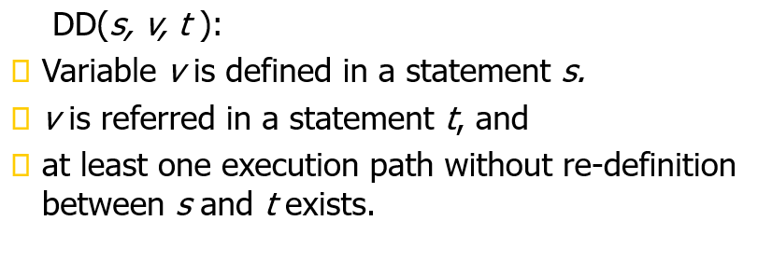
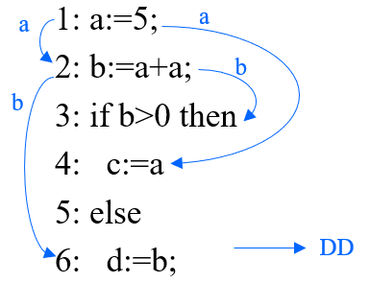
Data dependence
Notes:
When the following three conditions are all satisfied, a data dependence relation from s to t exists.
For example, DD(1,a,2) exists in this program, because the statement 1 defines the variable a, and the statement 2 refers the definition.

Slide 11
Control dependence
Notes:
When the following two conditions are all satisfied, a control dependence relation from s to t exists.
In this example, the predicate 3 controls the execution of the statement 4 and 6, therefore, CD(3,4) and CD(3,6) exist.
We can say that program slice is a set of statements on which a slicing criterion depends directly and indirectly.

Slide 12
Program Slicing
Extract an executable subset of a program that (potentially) affects the values at a particular program location
Slicing criterion = program location + variable
An observer focusing on the slicing criterion cannot distinguish a run of the program from a run of the slice
12

Slide 13
Example
var n = readInput(); var i = 1;
var sum = 0; var prod = 1; while (i <= n) {
sum = sum + i; prod = prod * i; i = i + 1;
}
console.log(sum); console.log(prod);

Slide 14
Example
var n = readInput(); var i = 1;
var sum = 0; var prod = 1; while (i <= n) {
sum = sum + i; prod = prod * i; i = i + 1;
}
console.log(sum); console.log(prod);
Slice for value of sum at this statement?

Slide 15
Example
var n = readInput(); var i = 1;
var sum = 0; var prod = 1; while (i <= n) {
sum = sum + i;
prod = prod * i; i = i + 1;
Slice for value of sum at this statement?
}
console.log(sum);
console.log(prod);

Slide 16
Example
var n = readInput(); var i = 1;
var sum = 0; var prod = 1; while (i <= n) {
sum = sum + i; prod = prod * i; i = i + 1;
Slice for value of prod at this statement
}
console.log(sum);
console.log(prod);

Slide 17
Example
var n = readInput(); var i = 1;
var sum = 0; var prod = 1; while (i <= n) {
sum = sum + i; prod = prod * i; i = i + 1;
}
console.log(sum); console.log(prod);
Slice for value of n at this statement

Slide 18
Why Do We Need Slicing?
Various applications, e.g.
Debugging: Focus on parts of program relevant for a bug
Program understanding: Which statements influence this statement?
Change impact analysis: Which parts of a program are affected by a change? What should be retested?
Parallelization: Determine parts of program that can be computed independently of each other

Slide 19
Slicing: Overview
Forward vs. backward
Backward slice (our focus): Statements that influence the slicing criterion
Forward slice: Statements that are influenced by
the slicing criterion
Static vs. dynamic
Statically computing a minimum slice is undecidable
Dynamically computed slice focuses on particular
execution/input

Slide 20
Kinds of program slicing
Static slicing
using static information(a source program)
Dynamic slicing
using dynamic information(an execution trace)
Notes:
#Program slicing means to extract a program slice.
To tell the truth, program slicing can be roughly divided into two methods. Static slicing and dynamic slicing.
Static slicing only uses static information which is a source program.
Dynamic slicing only uses dynamic information which is an execution trace.
And, to calculate a program slice, we have to extract two dependence relations.
Data dependence and control dependence.

Slide 21
Static Program Slicing

Slide 22
Static Program Slicing
Various algorithms to compute slices
Here: Graph reachability problem based on program dependence graph

Slide 23
Program Dependence Graph
Directed graph representing the data and control dependences between statements
□ Nodes:
Q Statements
Q Predicate expressions
□ Edges:
Q Data flow dependences: One edge for each definition-use pair
Q Control flow dependences

Slide 24
Variable Definition and Use
A variable definition for a variable v is a basic block that assigns to v
Q v can be a local or global variable, parameter, or property
A variable use for a variable v is a basic block that reads the value of v
Q In conditions, computations, output, etc.

Slide 25
Definition-Clear Paths
A definition-clear path for a variable v is a path n₁, .., n_{k} in the CFG such that
n₁ is a variable definition for v
n_{k} is a variable use for v
No n_{i} (1 < i ≤ k) is a variable definition for v
Q n_{k} may be a variable definition if each assignment to v occurs after a use

Slide 26
Definition-Use Pair
A definition-use pair (DU-pair) for a variable v is a pair of nodes (d, u) such that there is a definition-clear path d, .., u in the CFG

Slide 27
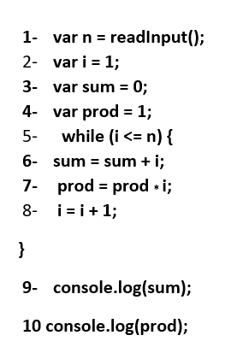
Data flow dependences:
Example

Slide 28
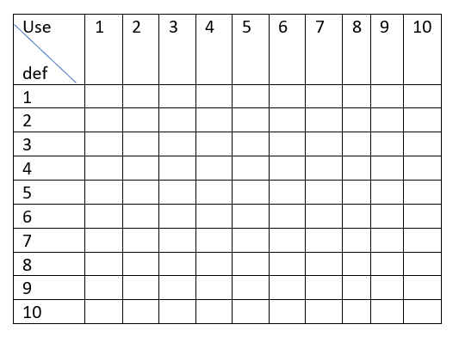
Data flow dependences:
Example

Slide 29
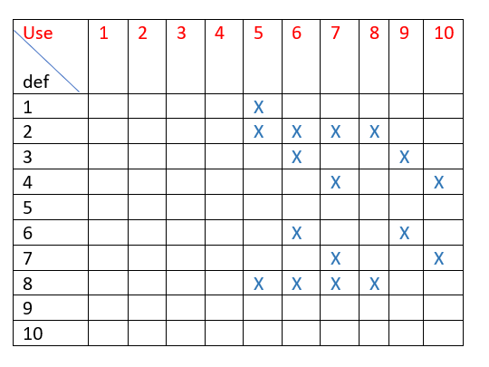
Data flow dependences:
Example
85

Slide 30
Control Flow Dependences
Post-dominator:
Node n₂ (strictly) post-dominates node n₁(/= n₂) if every path n₁, ..., exit in the control flow graph contains n₂
Control dependence:
Node n₂ is control-dependent on node n₁ /= n₂ if Q there exists a control flow path P = n₁, ..., n₂ where n₂ post-dominates any node in P (excluding n₁),
and
Q n₂ does not post-dominate n₁
17

Slide 31
Control Flow Dependences:
Example
(strictly) post-dominates
Control dependence

Slide 32
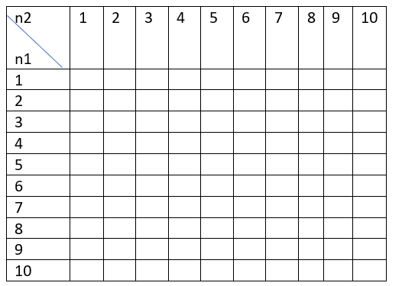
Control Flow Dependences:
Example
1) (strictly) post-dominates
2) Control dependence

Slide 33
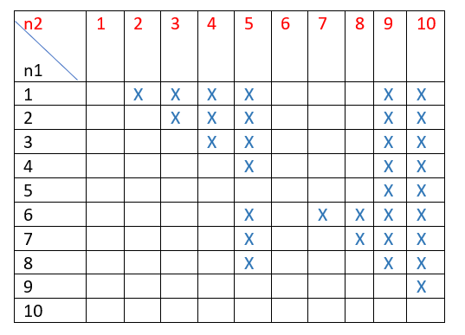
Control Flow Dependences:
Example
1) (strictly) post-dominates
2) Control dependence: 6 is Control dependence on 5
7 is Control dependence on 5
8 is Control dependence on 5

Slide 34
Computing Slices
Given:
Program dependence graph G_{PD}
Slicing criterion (n, V ), where n is a statement and V is the set of variables defined or used at n
Slice for (n, V ):
All statements from which n is reachable (i.e., all statements on which n depends)
20

Slide 35
Program Dependence Graph: example
1
2
3
4
5
9
10
6
7
8

Slide 36
Program Dependence Graph: example
1
2
3
4
5
9
10
6
7
8

Slide 37
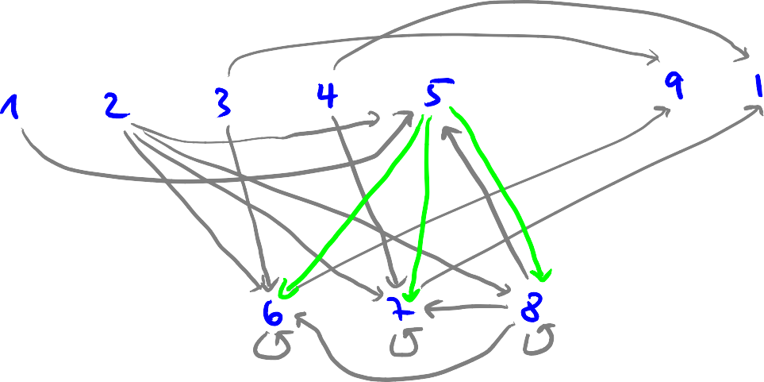
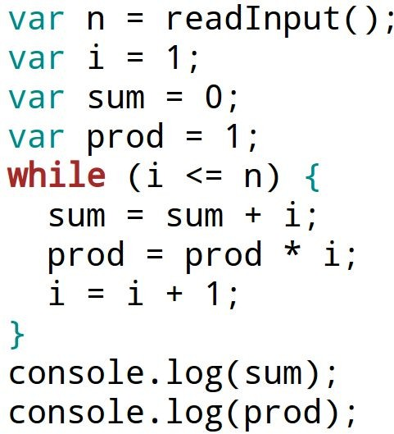
Program Dependence Graph: example
Slice (9, {sum} )
= { n I reachable (n,9)}
= {1,2,3,5,6,7,8,9}

Slide 38
Ch 4: Program Comprehension
Part 4
Program Analysis
Code Refactoring

Slide 39
Refactoring: what is it?
Definition: Refactoring is a disciplined technique for restructuring an existing body of code, altering its internal structure without changing its external behavior.
Refactoring does not fix bugs, but it may help find bugs. It may also reduce the further introduction of bugs by cleaning-up code.
It is an essential part of agile software development such as Extreme Programming or incremental development.

Slide 40
Refactoring
Definition: Refactoring modifies software to improve its readability, maintainability, and extensibility without changing what it actually does.
External behavior does NOT change
Internal structure is improved
The goal of refactoring is NOT to add new functionality
The goal is refactoring is to make code easier to maintain in the future

Slide 41
Refactoring: when?
Refactoring ought to be done continuously as “bad smells” are encountered during programming.
“Bad smells” or “anti-patterns” are portions of design or code that are characterized as potentially confusing and identifies as refactoring targets.
More importantly, when using iterative development, a major refactoring stage should precede the beginning of the development of a new build. This will remove slight design problems and ease the addition of further functionality.

Slide 42
Refactoring: why?
Refactoring is usually done to:
Improve quality
improve design quality
improve maintainability
improve extensibility
Improve sustainability of development
requires proper testing, so improves testability
helps to find bugs
Improve productivity
improve code readability & comprehensibility
simplify code structure

Slide 43
Why do good developers write bad software?
Requirements change over time, making it hard to update your code (leading to less optimal designs)
Time and money cause you to take shortcuts
You learn a better way to do something (the second time you paint a room, it’s always better than the first because you learned during the first time!)

Slide 44
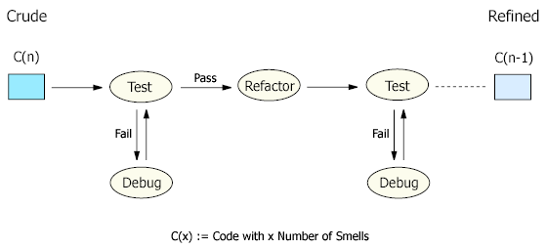
Refactoring: how?
Each refactoring is implemented as a small behavior-preserving transformation.
Behavior-preservation is achieved through pre- and post-transformation testing.
Refactoring process: test-refactor-test

Slide 45
Refactoring: drawbacks
Cost Overhead: Refactoring is an add-on activity and therefore will incur extra cost in form of time, effort, and resource allocation, especially if elaborated design and code documentation is maintained. However, when done sparingly and only on key issues, its benefits are greater than its overhead. Automated documentation tools, code browsing tools, refactoring tools and testing tools will also diminish the refactoring overhead.
Requires Expertise: Refactoring requires some expertise and experience and considerable effort in going through the process, especially if proper testing is involved. However, this overhead can be minimized by using refactoring tools and automated testing such as with a unit testing framework.

Slide 46
Refactoring: examples
Consolidate Conditional Expression: You have a sequence of conditional tests with the same result. Refactor by combining them into a single conditional expression and extract it.
double disabilityAmount() {
if (_seniority < 2) return 0;
if (_monthsDisabled > 12) return 0;
if (_isPartTime) return 0;
// compute the disability amount
double disabilityAmount() {
if (isNotEligibleForDisability()) return 0;
// compute the disability amount

Slide 47
Refactoring: examples
Consolidate Duplicate Conditional Fragments: The same fragment of code is in all branches of a conditional expression. Refactor by moving it outside of the expression.
if (isSpecialDeal()) {
total = price * 0.95;
send();
} else {
total = price * 0.98;
send();
}
if (isSpecialDeal())
total = price * 0.95;
else
total = price * 0.98;
send();

Slide 48
Refactoring: examples
Rename Method: The name of a method does not reveal its purpose. Refactor it by changing the name of the method.
int getInvCdtLmt(){
…
}
int getInvoiceableCreditLimit(){
…
}

Slide 49
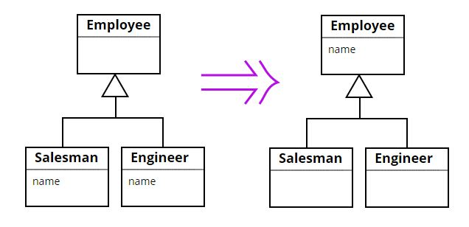
Refactoring: examples
Pull Up Field: Two subclasses have the same field. Refactor it by moving the field to the superclass.

Slide 50
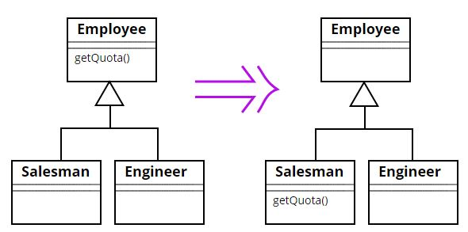
Refactoring: examples
Push Down Method: Behavior on a superclass is relevant only for some of its subclasses. Refactor it by moving it to those subclasses.

